Slide 1
APUSH Review: Famous Abolitionists
Everything You Need To Know About Abolitionists To Succeed In APUSH

Slide 2
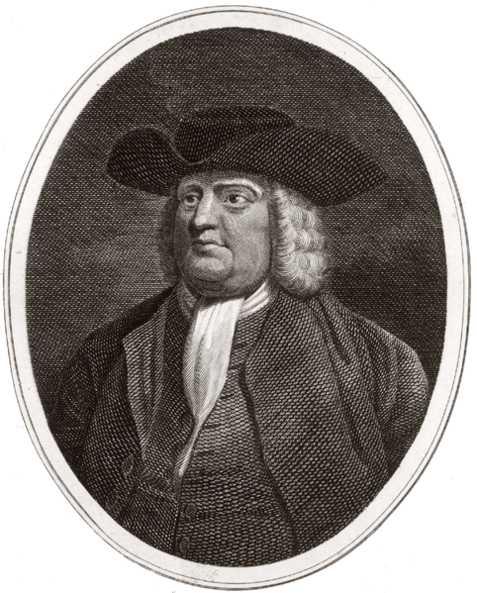
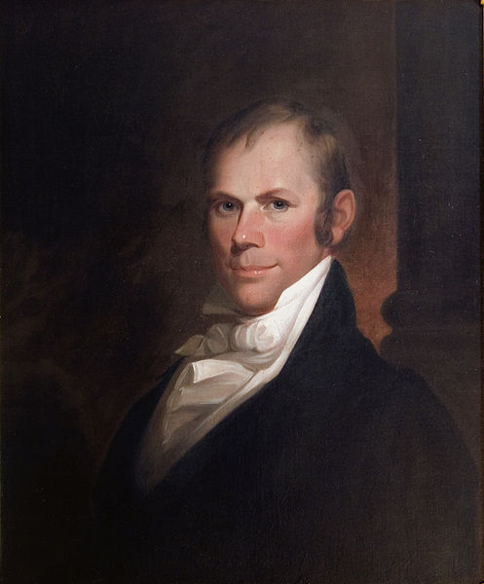
Early Abolitionism
Quakers
Colonial Era abolitionists
American Colonization Society
Founded in 1817
Goal was to send former slaves to Africa (Liberia)
Prominent members included Henry Clay, Abraham Lincoln (early on) and many others
Most African – Americans did NOT want to go

Slide 3
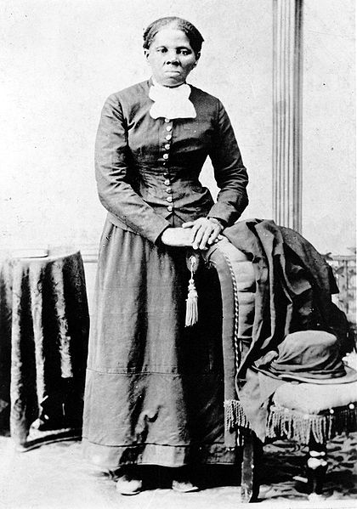
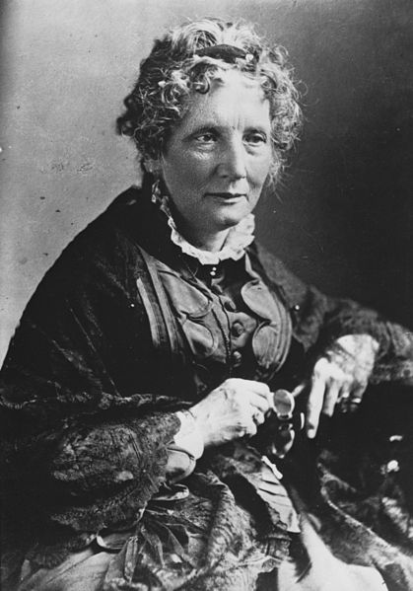
Important Abolitionists
Harriet Beecher Stowe
Uncle Tom’s Cabin
Showed the evils of slavery and breaking up families
Theodore Dwight Weld:
American Slavery As It Is
Married Angelina Grimké
Angelina and Sarah Grimké
Southern women that advocated abolitionism and women’s rights
Harriet Tubman:
Former slave, helped other slaves escape via the Underground Railroad
Helped over 300 slaves

Slide 4
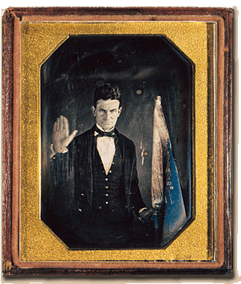
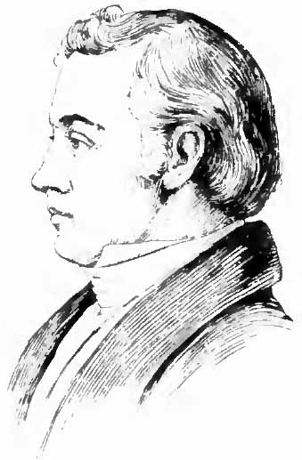
Important Abolitionists
David Walker
Called for unity among blacks, violence to end slavery
Elijah Lovejoy
Minster and newspaper editor from Illinois
A mob burned his warehouse where his printing press was; shot and killed
Helped inspire John Brown
John Brown:
Part of “Bleeding Kansas” and architect of the raid at Harpers Ferry

Slide 5
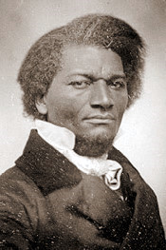
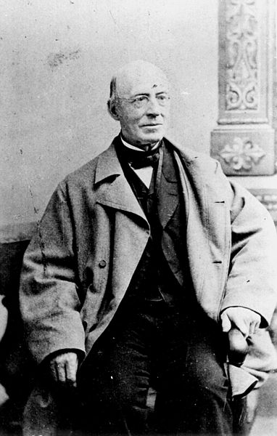
2 Absolutely Must-Know Abolitionists
William Lloyd Garrison:
The Liberator
Called for the immediate end to slavery without compensation
Disliked the Constitution since it allowed slavery; urged secession by the North
Frederick Douglass
Former slave, great orator, published The North Star
Traveled to Europe to speak against slavery
Attended the women’s rights movement at Seneca Falls

Slide 6
Thanks for watching!
Subscribe to APUSHReview.com
Help spread the word
Questions? Comments? Ideas for videos?
Leave in comments

